Slide 1
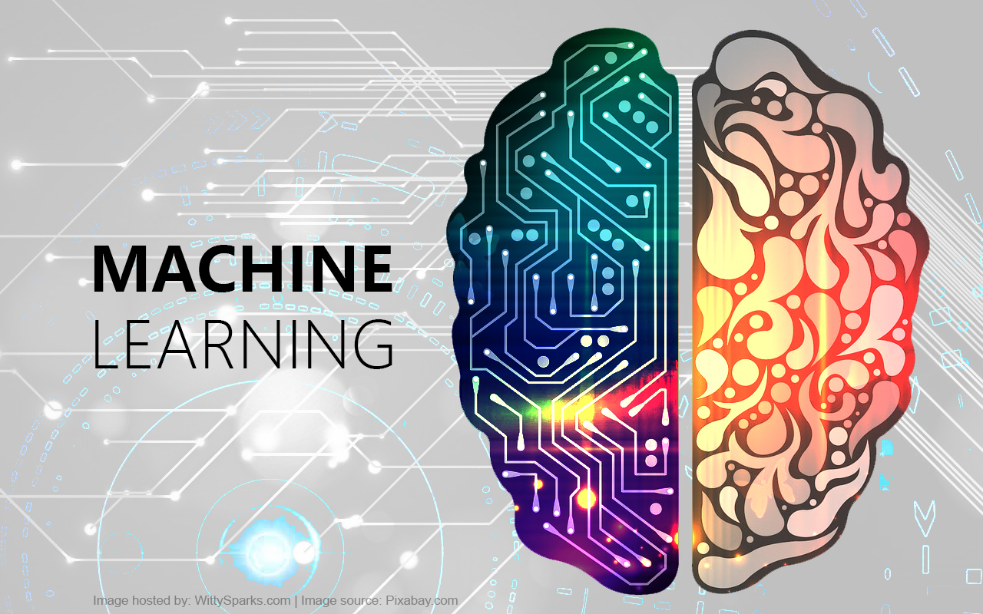
Introduction To Machine Learning
- Abhijeet Mote, Python Developer, Python Penang Meetup Organizer
- abhijeetmote@gmail.com
- https://groups.google.com/forum/#!forum/penang-python-meetup

Slide 2

What is Machine Learning ?

Slide 3

“[Machine Learning is the] field of study that gives computers the ability to learn without being explicitly programmed.” Arthur Samuel- 1959
“A computer program is said to learn from experience E with respect to some task T and some performance measure P, if its performance on T, as measured by P, improves with experience E.”
Tom Mitchell, 1997

Slide 4
if you want your program to predict,
for example, traffic patterns at a busy intersection (task T), you can run it through a machine learning algorithm with data about past traffic patterns (experience E) and, if it has successfully “learned”, it will then do better at predicting future traffic patterns (performance measure P).

Slide 5
Machine Learning is…
subfield of artificial intelligence (AI).
To understand the structure of data
fit that data into models that can be understood and utilized by people
Difference in traditional computing and Machine Learning
In traditional computing, algorithms are sets of explicitly programmed instructions used by computers to calculate or problem solve.
Machine learning algorithms instead allow for computers to train on data inputs and use statistical analysis in order to output value

Slide 6
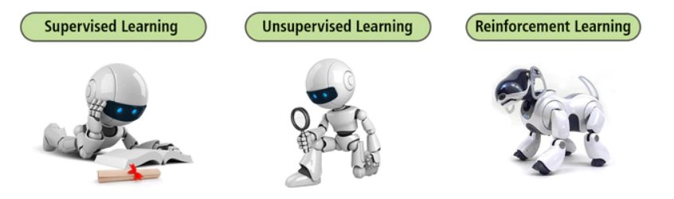
Machine Learning Methods
supervised learning which trains algorithms based on example input and output data that is labeled by humans
unsupervised learning which provides the algorithm with no labeled data in order to allow it to find structure within its input data.
Semi supervised which is combination of both supervised and unsupervised learning.
Reinforcement learning which involves the model to learn from its past errors and correct it in the next iteration

Slide 7
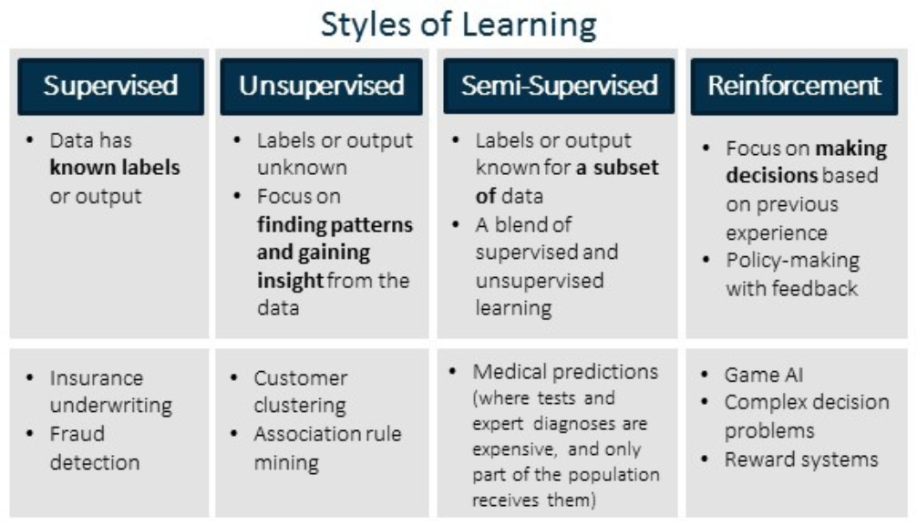

Slide 8
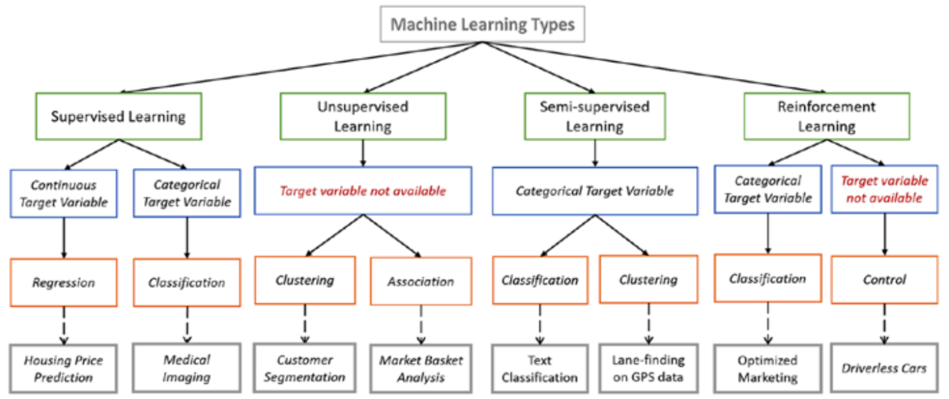

Slide 9
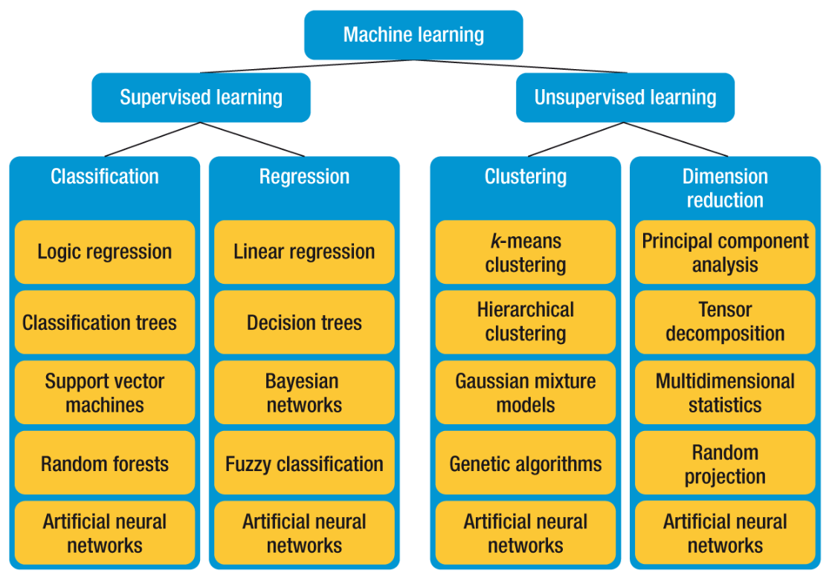

Slide 10
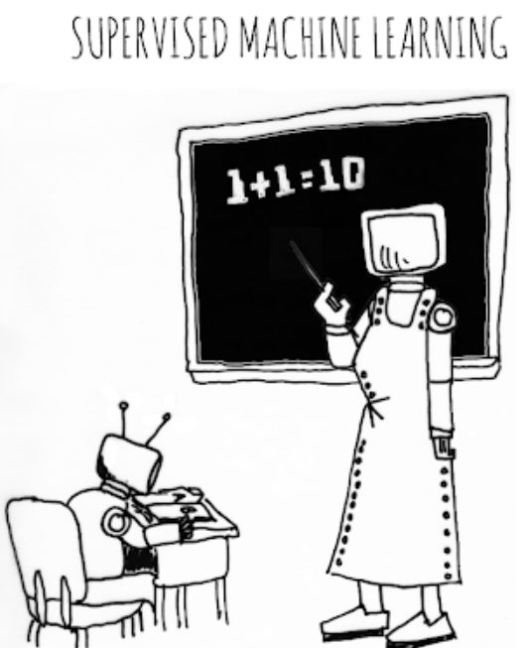
Supervised Learning

Slide 11
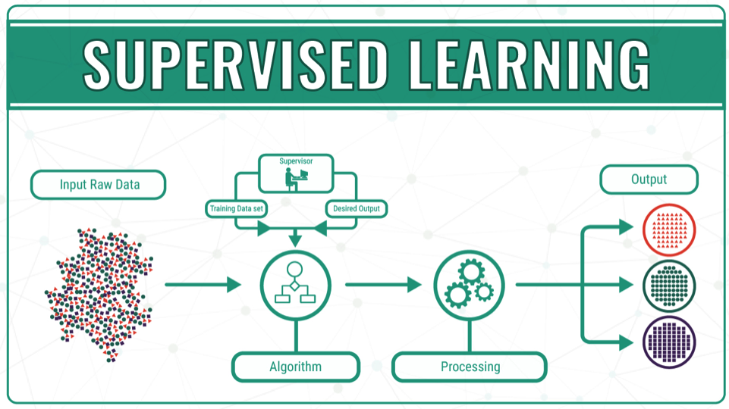
Predictive/Supervised model as the name suggests is used to predict the future outcome based on the historical data. Predictive models are normally given clear instructions right from the beginning as in what needs to be learnt and how it needs to be learnt. These class of learning algorithms are termed as Supervised Learning.

Slide 12
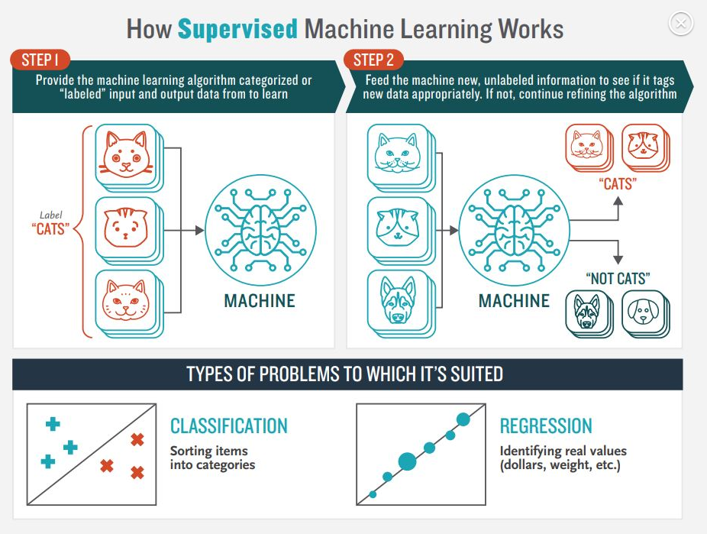

Slide 13
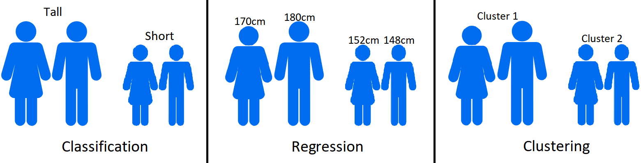

Slide 14
There are few really Popular supervised machine learning algorithms, such as:
Decision Trees
Naive Bayes Classification
Support vector machines for classification problems
Random forest for classification and regression problems
Linear regression for regression problems
Ordinary Least Squares Regression
Logistic Regression
Ensemble Methods

Slide 15
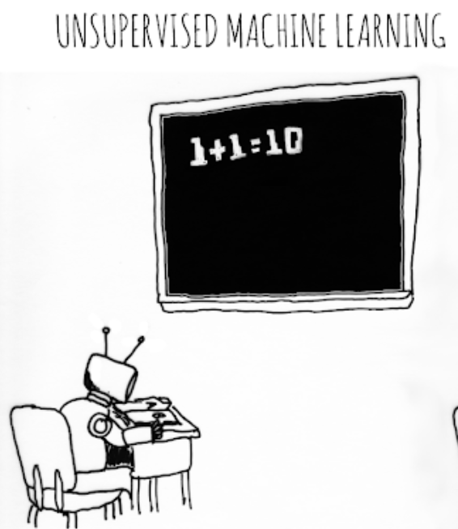

Slide 16
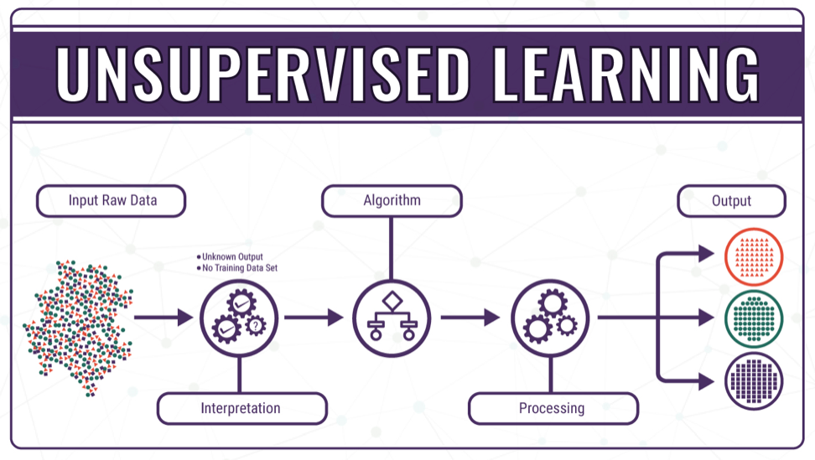
It is used to train descriptive models where no target is set and no single feature is important than the other. The case of unsupervised learning can be: When a retailer wishes to find out what are the combination of products, customers tends to buy more frequently

Slide 17
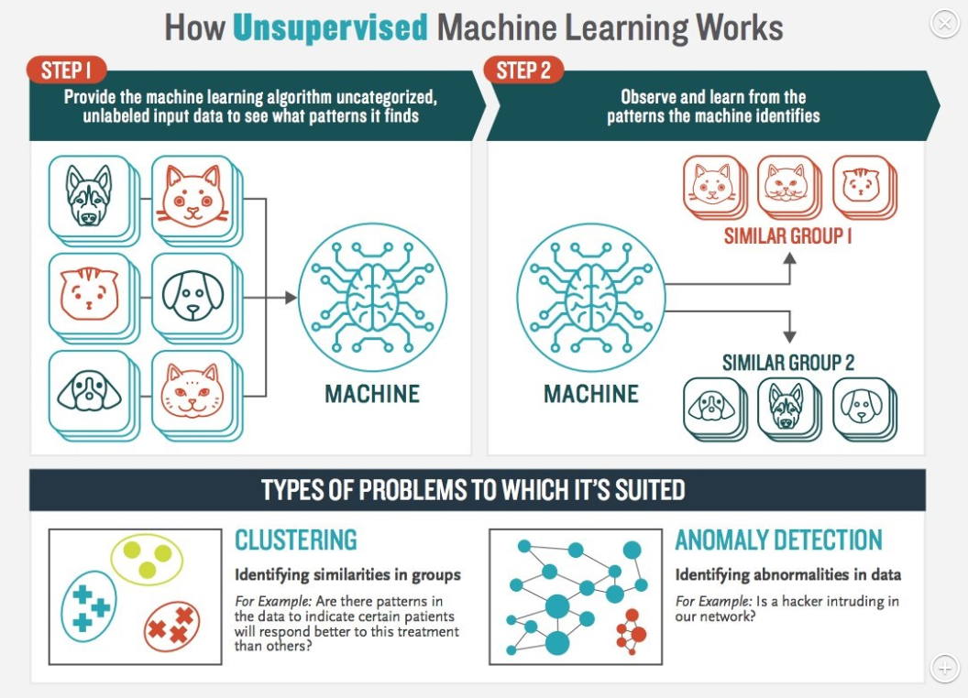

Slide 18
Some popular examples of unsupervised learning algorithms are:
K-means for clustering problems
Apriori algorithm for association rule learning problems
Principal Component Analysis
Singular Value Decomposition
Independent Component Analysis

Slide 19
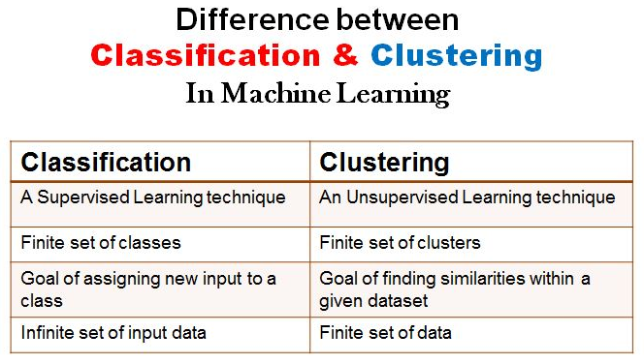

Slide 20
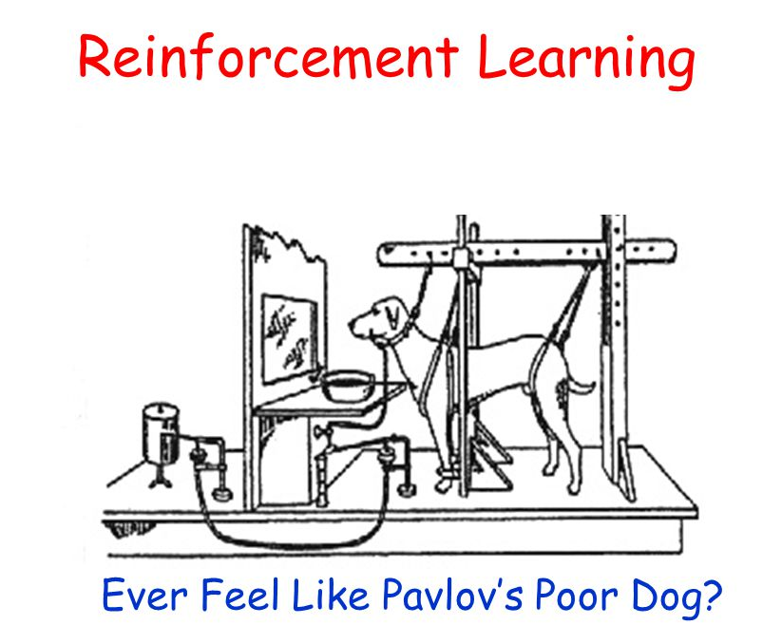

Slide 21
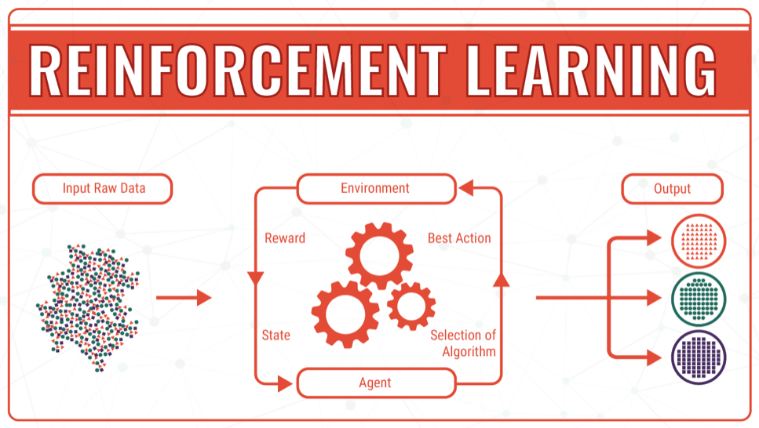
It is an example of machine learning where the machine is trained to take specific decisions based on the business requirement with the sole motto to maximize efficiency (performance). The idea involved in reinforcement learning is: The machine/ software agent trains itself on a continual basis based on the environment it is exposed to, and applies it’s enriched knowledge to solve business problems

Slide 22
Reference
https://www.newtechdojo.com/list-machine-learning-algorithms/#Unsupervised%20Learning
Google Machine Learning crash course

